Slide 1
Multiplying by zero
Multiplying by zero
Being able to generalise that ‘multiplying any number by zero gives a product of zero’ helps students apply this knowledge to situations such as 3 × 6 × 0.

Slide 2
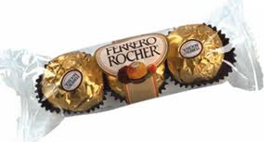
2 packets of 3 chocolates
Multiplying by zero
2 × 3 = 6

Slide 3
1 packet of 3 chocolates
Multiplying by zero
1 × 3 = 3

Slide 4
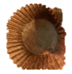
No packets of 3 chocolates
Multiplying by zero
Just 3 empty chocolate wrappers!
0 × 3 = 0

Slide 5
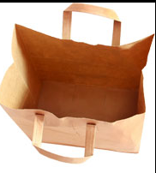
Real life story
Multiplying by zero
I had 3 bags and I put zero lollies in each bag.
How many lollies did I have?
Zero lollies!
3 × 0 = 0

